Slide 1

EE115 Analog and Digital Circuits
Topic 4: Logic Gates
Prof. Yajun Ha
ShanghaiTech University
Shanghai, China
This set of slides is by © Pearson Education

Slide 2

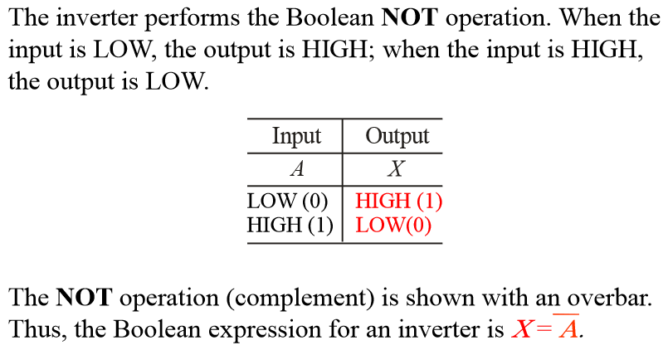
The Inverter (1)

Slide 3
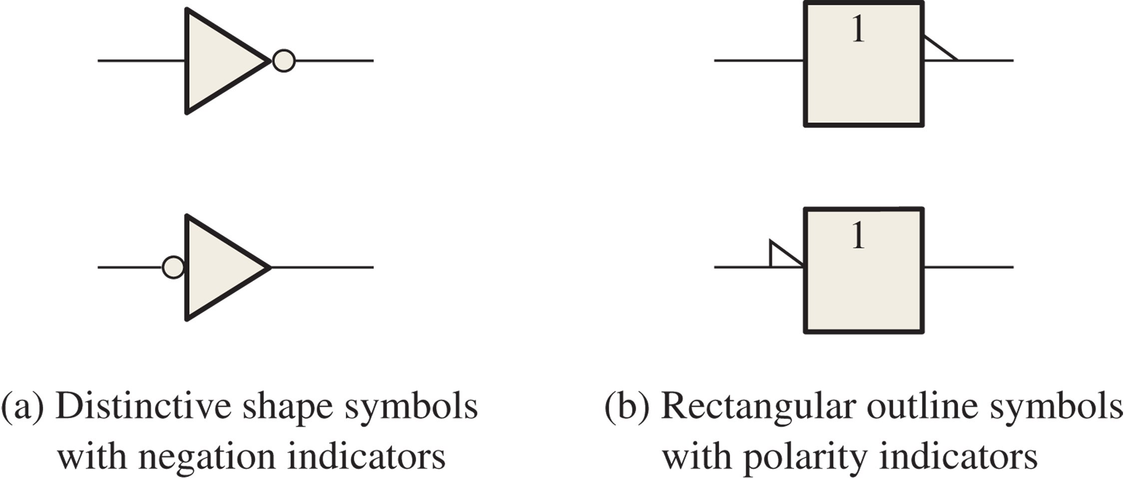
FIGURE 3-1 Standard logic symbols for the inverter (ANSI/IEEE Std. 91-1984/Std. 91a-1991).

Slide 4
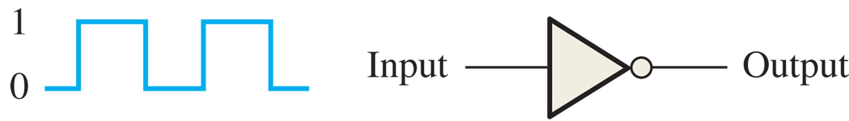
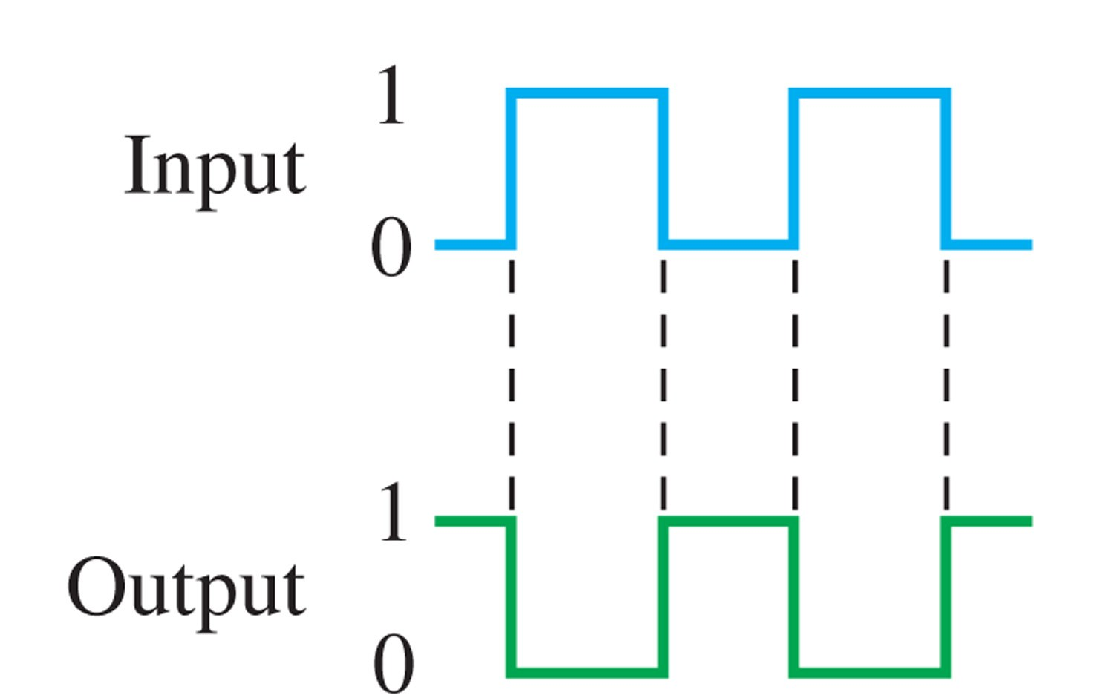
Example: Given the input, plot the output waveform.
Solution: See below for the timing diagram.

Slide 5

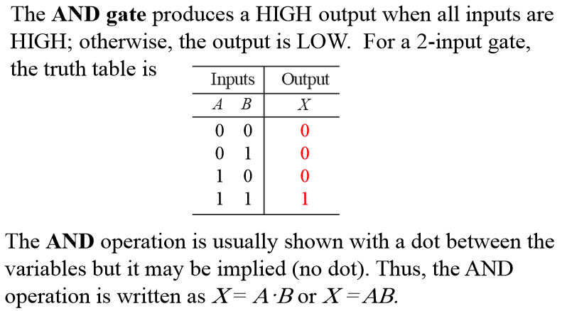
The AND Gate (1)
Prof. Yajun Ha
Notes:
Title

Slide 6
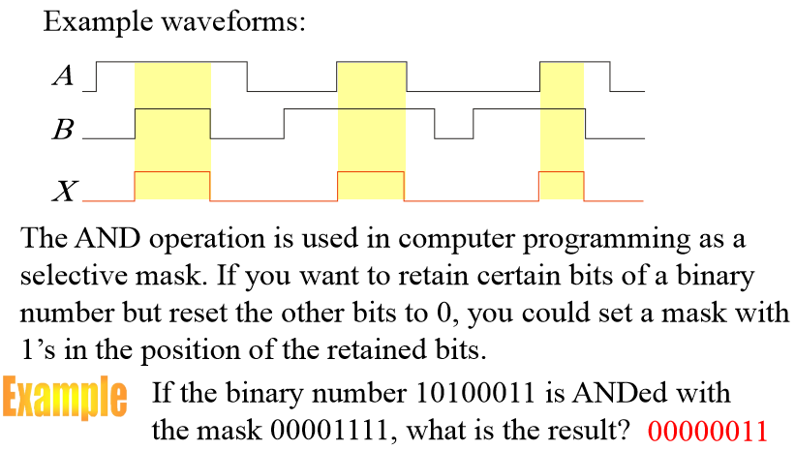
The AND Gate (3)

Slide 7

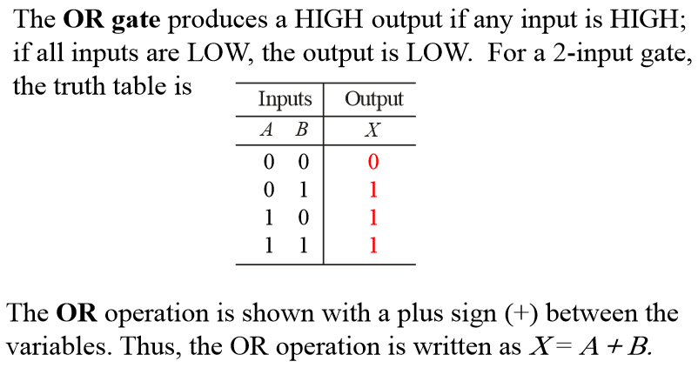
The OR Gate (1)
Prof. Yajun Ha
Notes:
Title

Slide 8
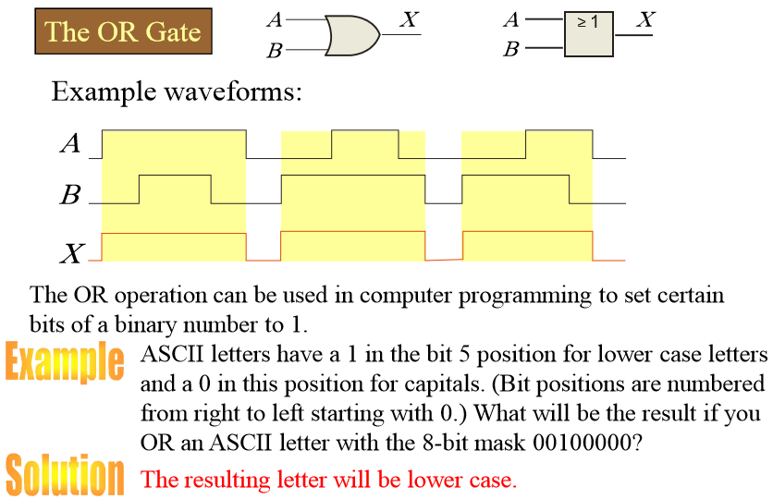
The OR Gate (2)
Prof. Yajun Ha
Notes:
Title

Slide 9

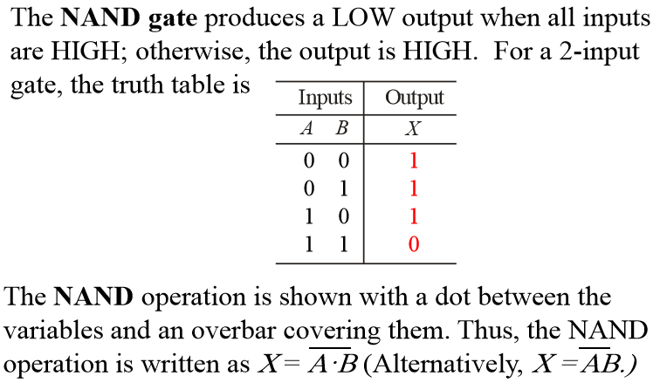
The NAND Gate (1)
Prof. Yajun Ha
Notes:
Title

Slide 10

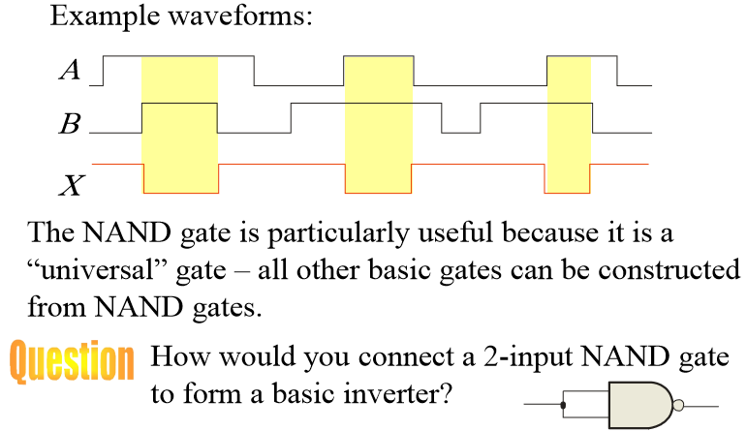
The NAND Gate (2)
Prof. Yajun Ha
Notes:
Title

Slide 11

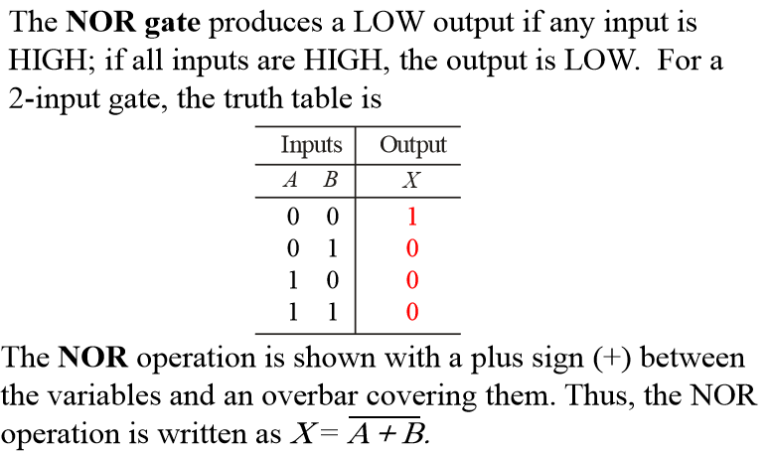
The NOR Gate (1)
Prof. Yajun Ha
Notes:
Title

Slide 12

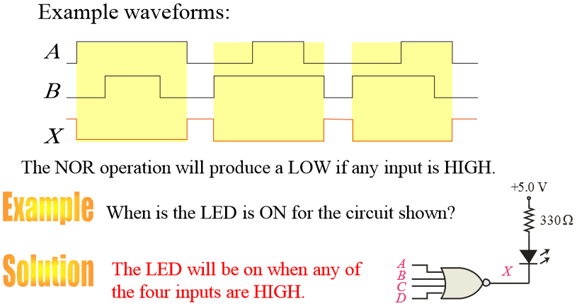
The NOR Gate (2)
Prof. Yajun Ha
Notes:
Title

Slide 13

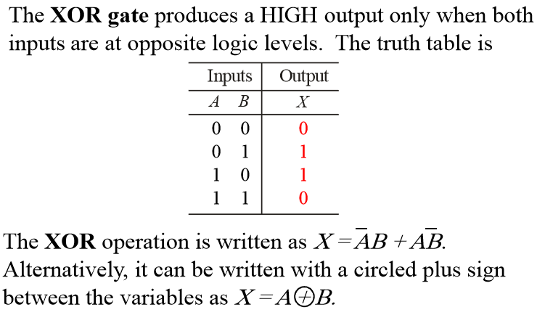
The XOR Gate (1)
Prof. Yajun Ha
Notes:
Title

Slide 14
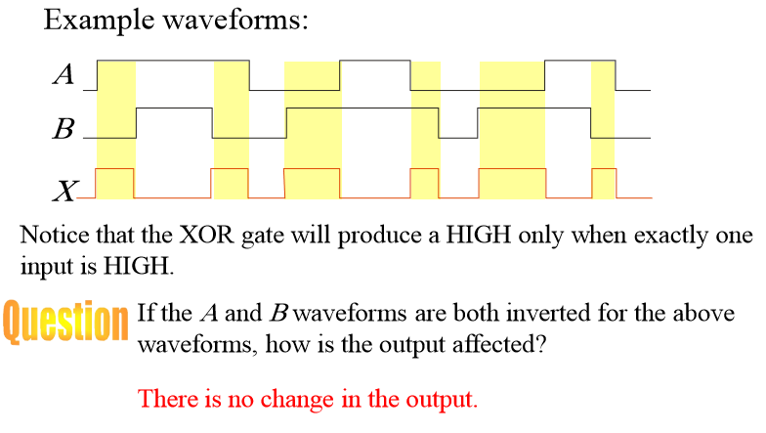
The XOR Gate (2)
Prof. Yajun Ha
Notes:
Title

Slide 15

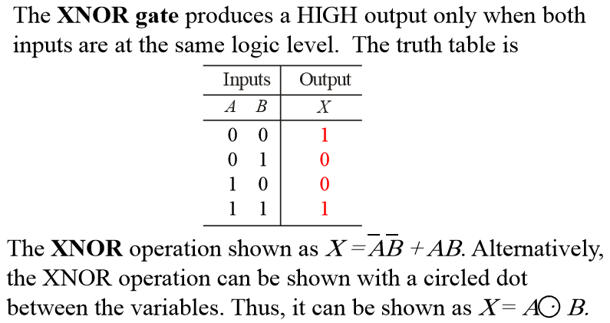
The XNOR Gate (1)
Prof. Yajun Ha
Notes:
Title

Slide 16
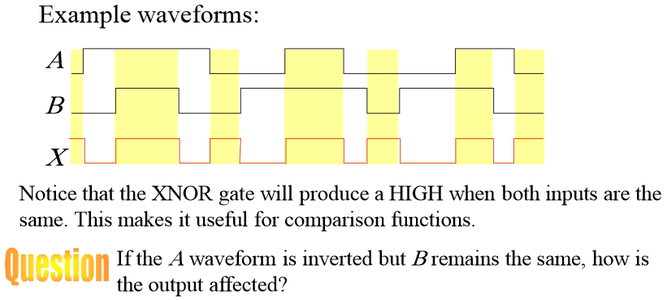

The XNOR Gate (2)
Prof. Yajun Ha
Notes:
Title

